Slide 1
Eclipses of a Lifetime
Ashwin, Bruno, Jacob, and Parvati

Slide 2
Background
Eclipses are astronomical phenomena where celestial bodies align
Solar eclipses occur when the moon obstructs light from the sun to the Earth
Can be partial, annular, hybrid, or total eclipses
Total solar eclipses are so rare that people travel long distances to view them in person
Lunar eclipses occur when the Earth obstructs light from the sun to the moon
Can be penumbral, partial, or total eclipses
Next total solar eclipse on April 8th
Just happens to be in the US!

Slide 3
Project Goals
Investigate the relationships between Geographic Location/Solar Eclipse Frequency and Geographic Location/Path Width (Ashwin)
Analyze different types of eclipses and examine whether they occur with greater frequency during specific months (Parvati)
Analyze time differences between solar and lunar eclipses with respect to years and eclipse type (Jacob)
Determine the ideal location for viewing solar eclipses, in terms of visibility and eclipse frequency (Bruno)

Slide 4
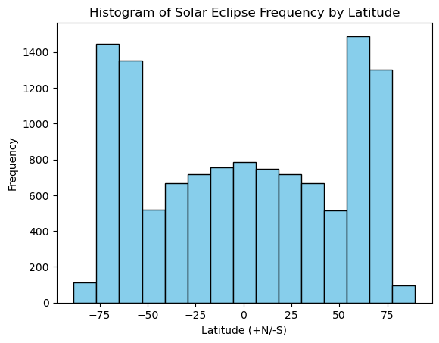
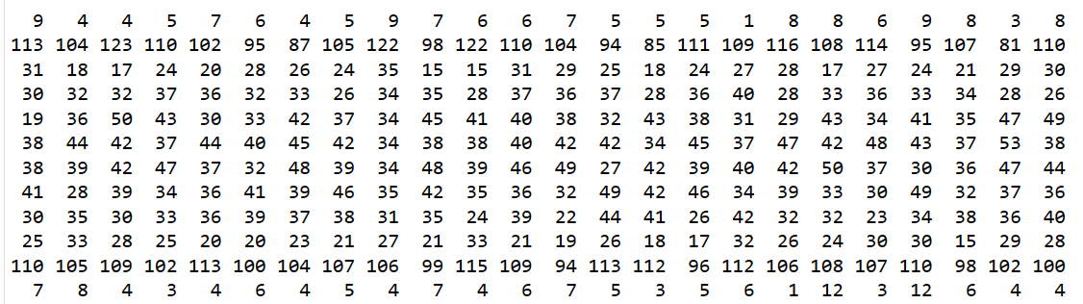
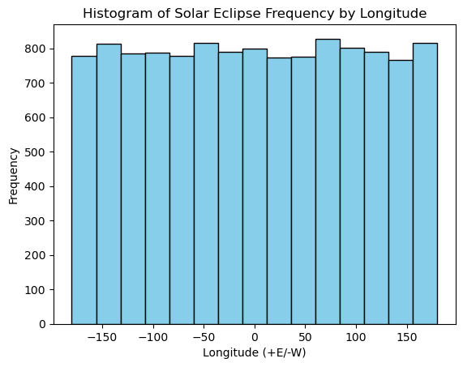
Analysis of Location and Solar Eclipse Frequency
Solar Eclipse Counts per 15x15 degree sector:
Chi^2 statistic=242.7, p-value=0.668, dof=253
1-way ANOVA test across each latitude:
statistic=706.7665019914394
p-value=5.294355553665398e-195
Takeaways:
Solar eclipse frequency does not depend on longitude
Solar eclipse frequency does depend on latitude

Slide 5
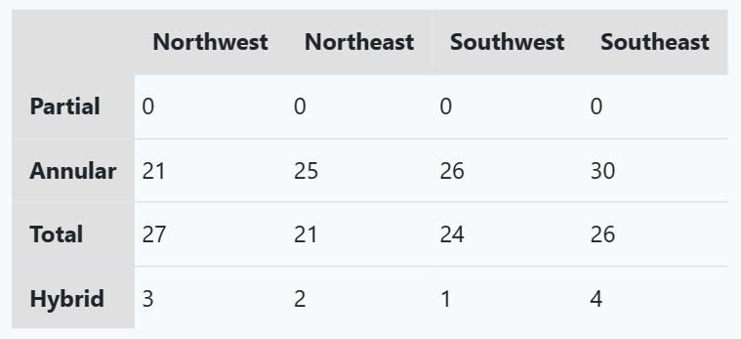
Analysis of US Location and Solar Eclipse Type
Analysis of Hemisphere and Mean Path Width
Takeaways:
Frequency of solar eclipse types does not depend on geographic location in the US
Partial and Hybrid solar eclipses are incredibly rare in the US
Annular and Total solar eclipses are similar in frequency in the US
Mean path width likely does not depend on geographic location
Chi-Square Test: statistic=2.9, p-value=0.820, dof=6
2 sample t-test for means between northern and southern path width:
statistic=-1.485
p-value=0.138
df=7512.36
2 sample t-test for means between eastern and western path width:
statistic=-0.952
p-value=0.341
df=7494.69

Slide 6
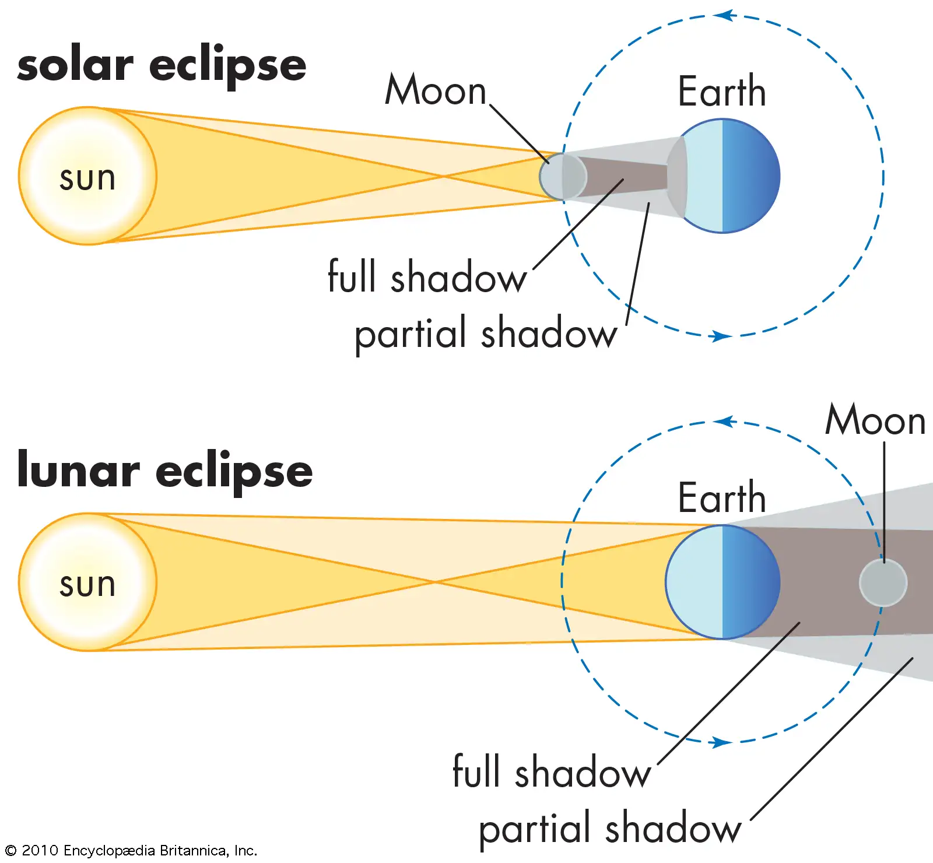
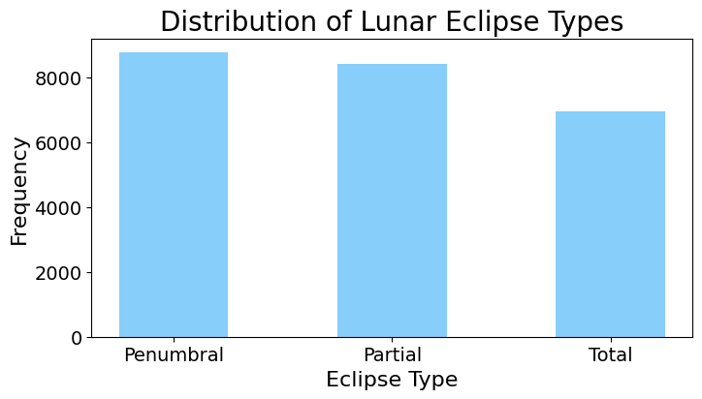
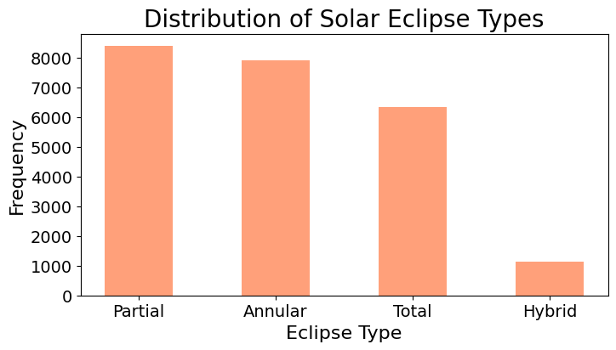
Types of Lunar and Solar Eclipses

Slide 7
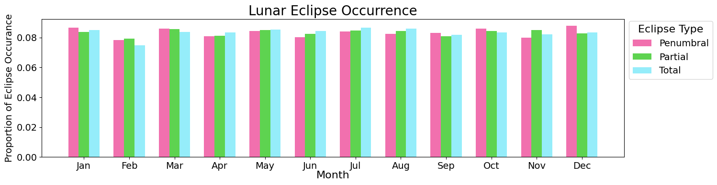
Lunar Eclipse Occurance
Penumbral eclipses occurring in May
95% CI: ( 0.07627 , 0.09275 )
Partial eclipses occurring in May
95% CI: ( 0.07666 , 0.09352 )
Total eclipses occurring in May
95% CI: ( 0.07608 , 0.09465 )
Chi-square test of independence: statistic = 8.97, df = 2, p-value = 0.011

Slide 8
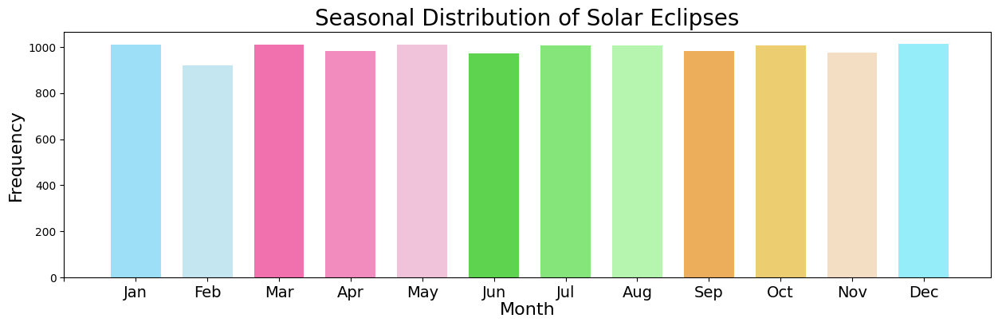
Seasonal Distribution of Solar Eclipses
Chi-Squared Test for Solar Eclipse Frequency Across Months:
statistic (chi-square) = 8.358
df = 11
p-value = 0.6809

Slide 9
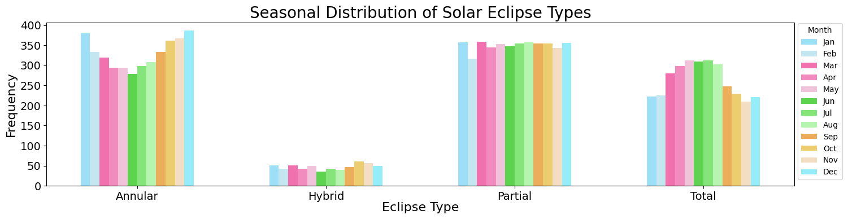
Seasonal Distribution of Solar Eclipse Types
Annular
statistic = 45.27
df = 11
p-value = 4.34e-06
Hybrid
statistic = 11.66
df = 11
p-value = 0.39
Partial
statistic = 4.14
df = 11
p-value = 0.96
Total
statistic = 72.93
df = 11
p-value = 3.38e-11

Slide 10
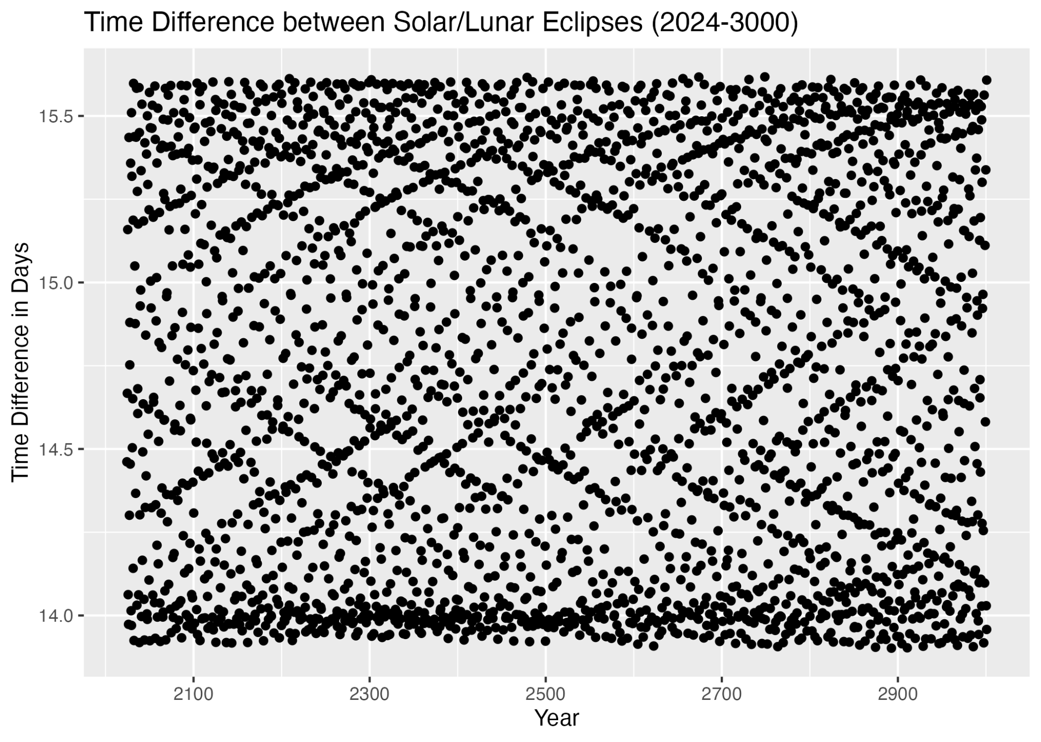
Time Difference between Solar and Lunar Eclipses
Two sample t-test for means:
Group 1 yrs. 1 A.D. - 2023, Group 2 yrs. 2024-3000:
p-value = 0.874
df = 8046
95% confidence interval: (-0.0246, 0.0289)
Takeaways:
No significant difference in group means
High periodicity based on time series analysis
Low variability with maxima around 15.75 days and minima around 13.75 days

Slide 11
Time Difference by Eclipse Type
ANOVA test for time differences by eclipse type:
p-value = 0.00538
df = 4
F-stat = 3.677
Linear Regression for time differences by eclipse type:
Reference Category: Annular Eclipse (occur yearly)
Partial: p-value = 0.000952
Total: p-value = 0.001351
95% CI for Total Eclipse Time Difference: (0.0234, 0.0971)
Takeaways:
Significant difference in eclipse type mean time difference
Partial and Total eclipses see time differences longer than a difference that includes an annular eclipse
Total eclipses on average 0.56-2.33 hour longer time difference between eclipses

Slide 12
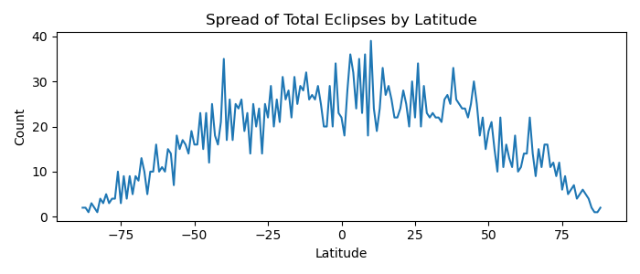
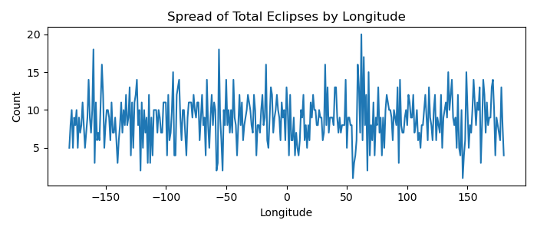
Ideal Viewing Locations For Total Eclipses
A combination of:
High eclipse frequency
High visibility
Low cloud cover
Higher frequency near 0 latitude
No significant difference across longitude
When factoring in visibility…

Slide 13
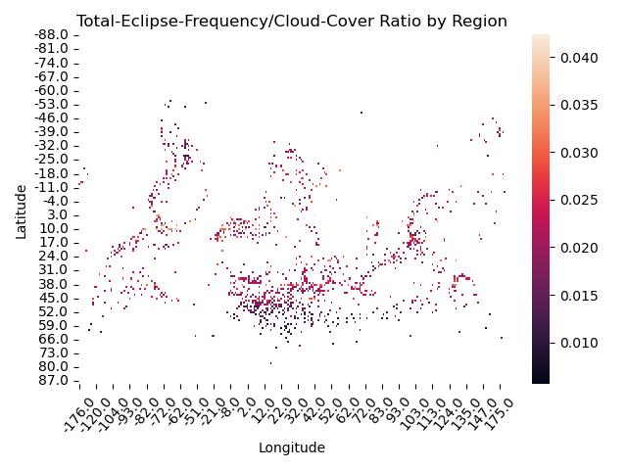
Ideal Viewing Locations
The locations with the best chances of seeing an eclipse are:
42.0 3.0
-63.0 10.0
-65.0 10.0
99.0 10.0
-76.0 10.0

Slide 14
Questions?

